Slide 1
If - else if - else

Slide 2
Today:
Short lesson adding else if to what we learned earlier.
Time to complete your homework from last time.
A couple exercises using if/else if/else.

Slide 3
is first condition
true?
False
True
is second condition
true?
False
True
Statement 1
Statement 2
Statement 3
Next Statement

Slide 4
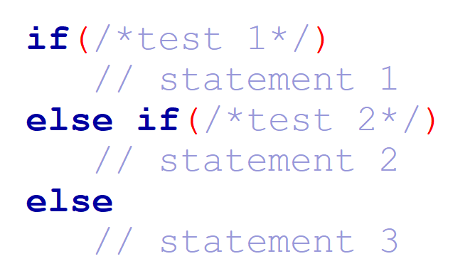
How this looks in C++

Slide 5
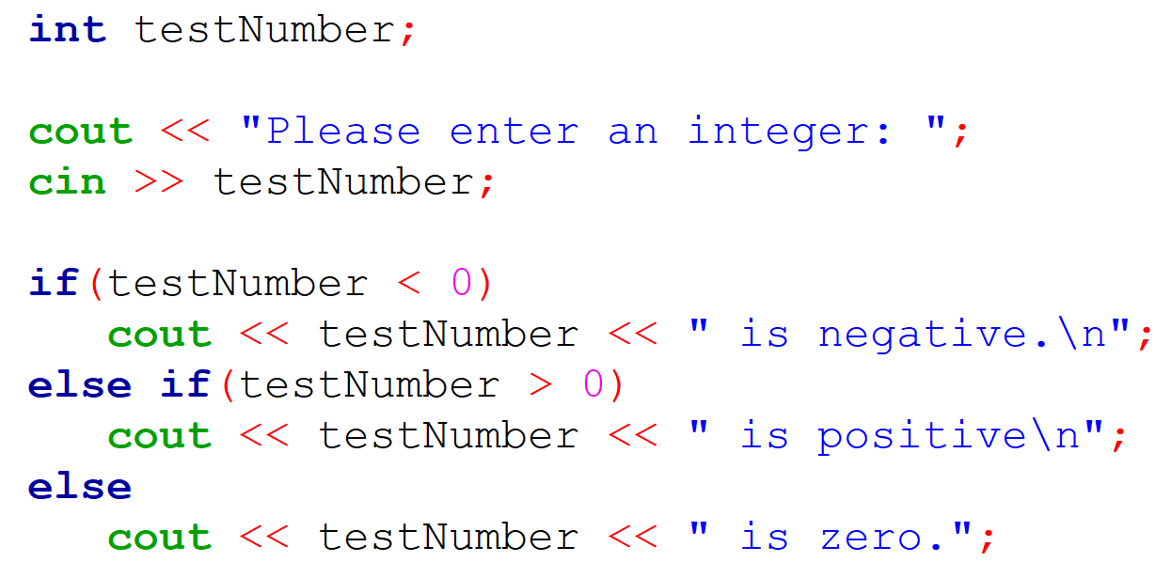
Let’s look at an introductory example:
Notes:
Notice that we don’t need to test that the number is equal to zero.

Slide 6
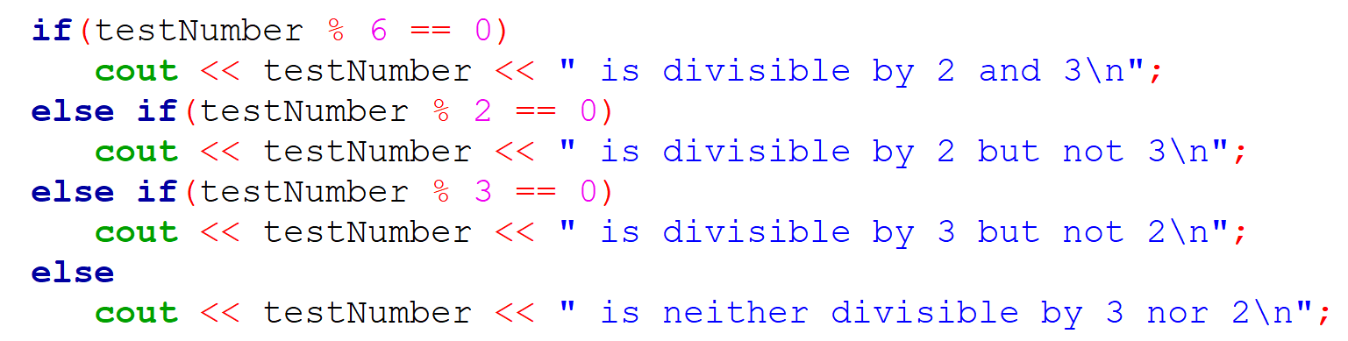
Consider the example below:
Why didn’t we write the following in the above code?

Slide 7
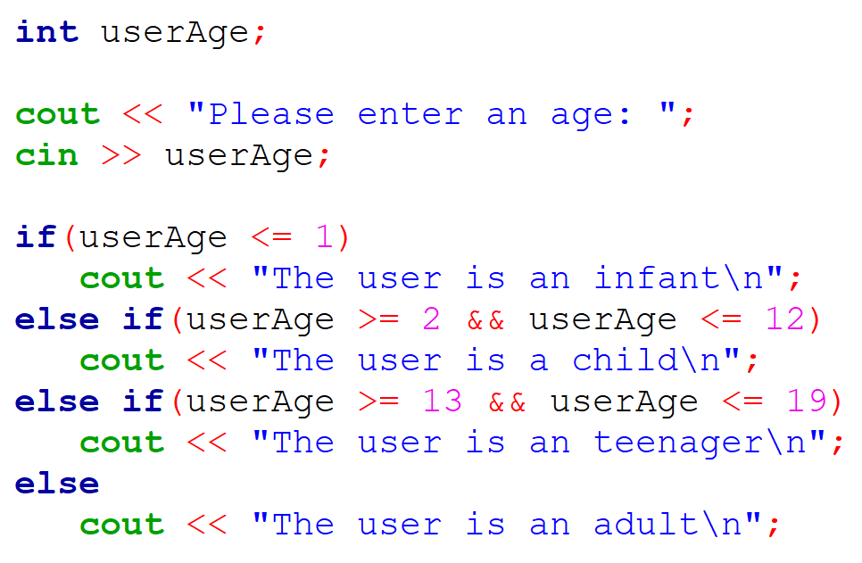
How can we improve this?

Slide 8
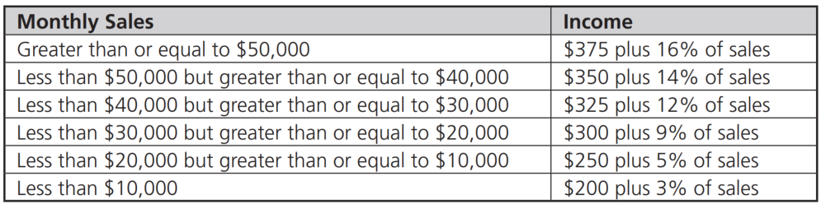
Exercise 1
Prompt a user for their total sales and calculate their income based on the following table.
Then output the result.

Slide 9
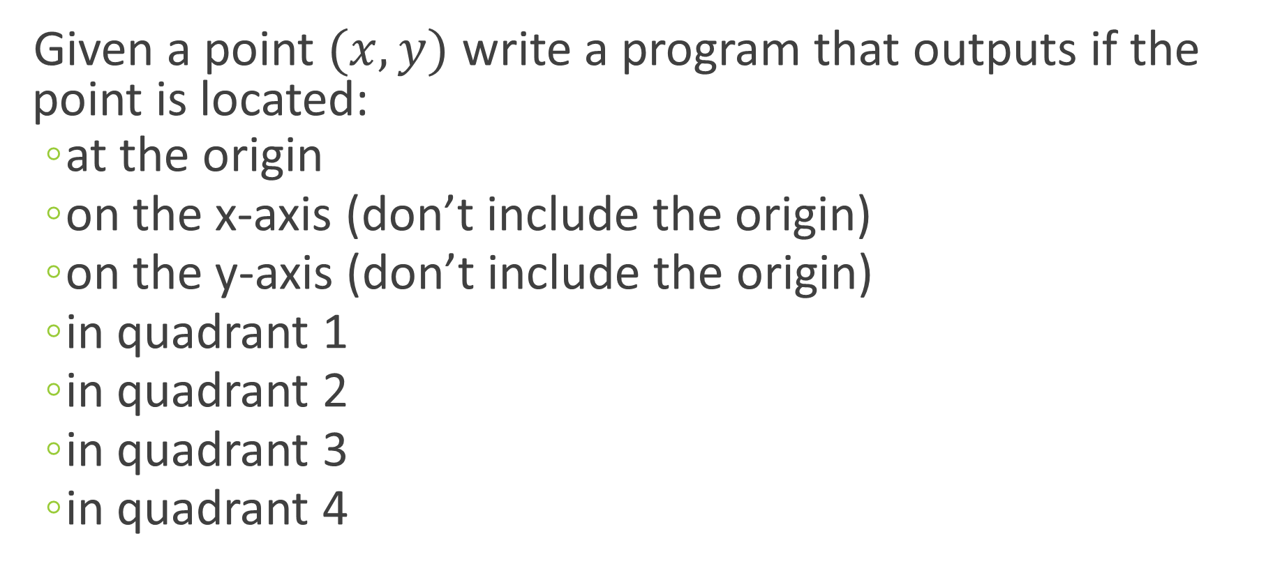
Exercise 2:
Given a point $(x, y)$ write a program that outputs if the point is located:
at the origin
on the x-axis (don’t include the origin)
on the y-axis (don’t include the origin)
in quadrant 1
in quadrant 2
in quadrant 3
in quadrant 4

